Slide 1
Redefining Trauma
The Case of Occupied Palestine: Local Lenses
Yo’ad Ghanadry Hakim
Clinical Psychologist
Palestinian Counseling Center
PCC

Slide 2

Classical Definition of PTSD

Slide 3
Defining Trauma
PTSD- has long been understood as a mental trauma that affects the individual .
PTSD is included in a new category in DSM-5, Trauma- and Stressor-Related Disorders :
Criterion A: stressor
Criterion B: intrusion symptoms
Criterion C: avoidance
Criterion D: negative alterations in cognitions and mood
Criterion E: alterations in arousal and reactivity
Criterion F: duration
Criterion G: functional significance
Criterion H: exclusion

Slide 4
Traditional Cases
Natural Disasters
Tragic Events
Bombings/Explosions
War
Accidents
Assaults

Slide 5

We question the PTSD definition
Criteria
A
B
C
F
G

Slide 6
W Who Seeks Counseling/therapy in tine who seeks counseling - therapy in Palestine and why n Palestine and why?
المركز الفلسطيني للإرشاد
Palestinian Counseling Center
The Thirty-year Pattern of Adult Mental Health Service Utilization in a Non-profit Centre in the West Bank

Slide 7

UNRWA in the Near East - Palestine
A personal experience of as a Technical consultant for UNRWA Mental Health program in 19 refugee camps - 19 camps in the West Bank

Slide 8

Local lenses

Slide 9
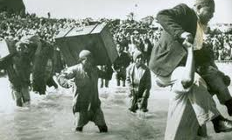
And there, the story began….1948
Criteria A –Stressor
Personal and professional questions

Slide 10
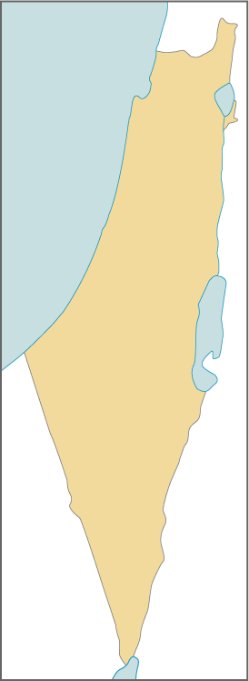
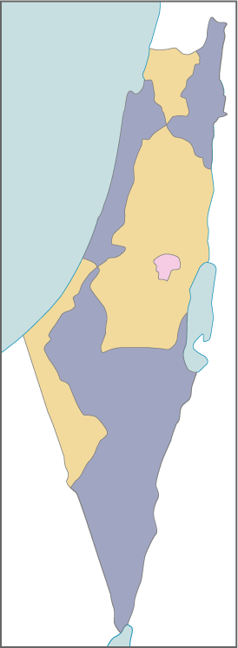
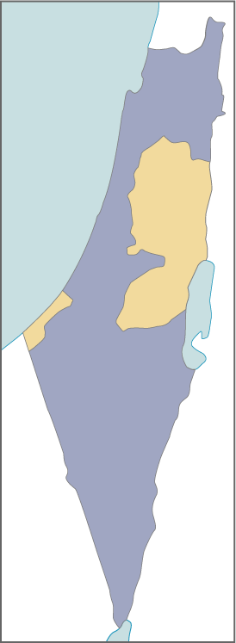
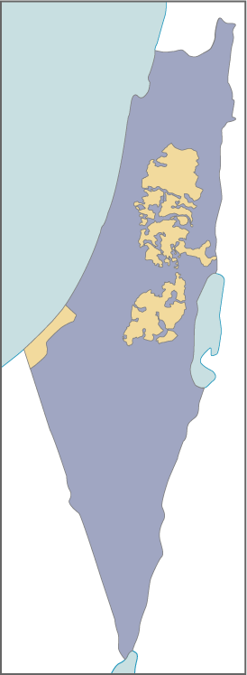
100%
44%
22%
14%

Slide 11
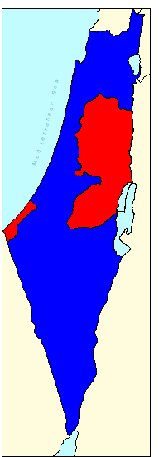
What happens since then:
Pursuant to UNSCR 242 and the Madrid International Conference
PALESTINIAN TERRITORIES:
West Bank and Gaza
According to Oslo Agreement 1993 Israel had to withdraw from WB. & Gaza. This has to be implemented on three phases: 1- from areas called A, 2- redeployment from area B, 3- from C areas
West Bank
Gaza

Slide 12
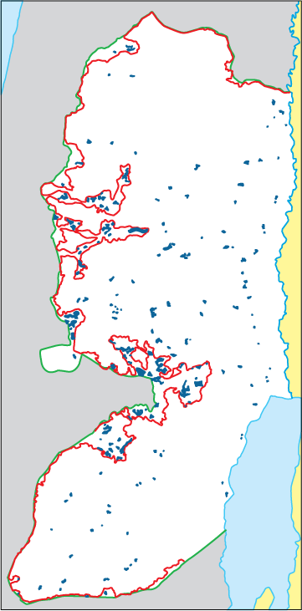

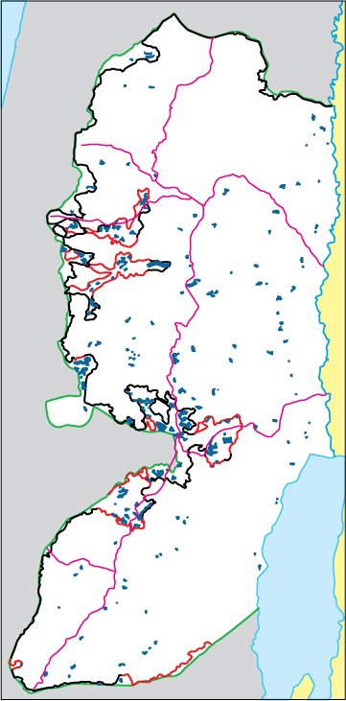
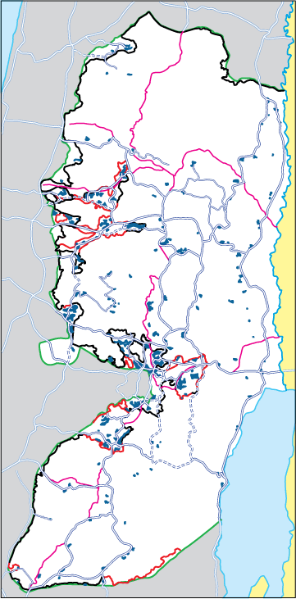
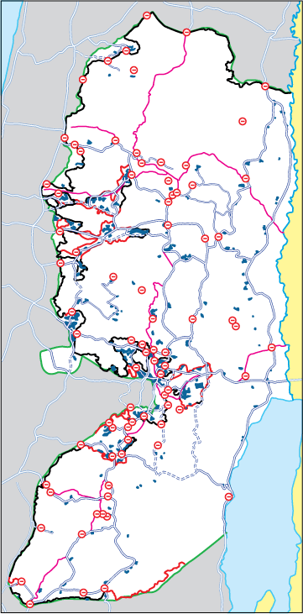
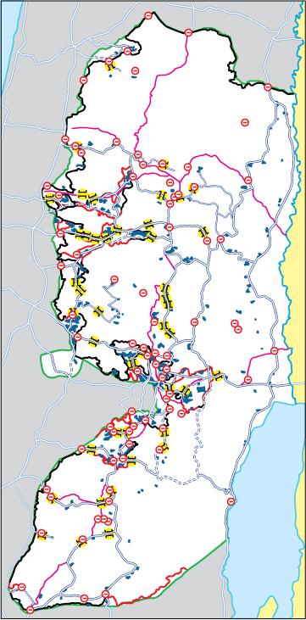
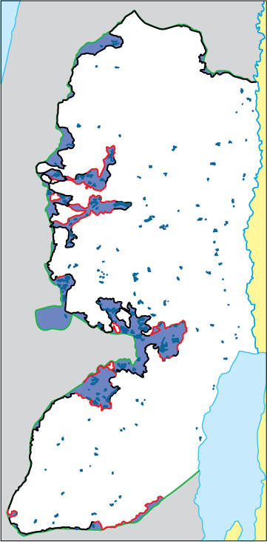
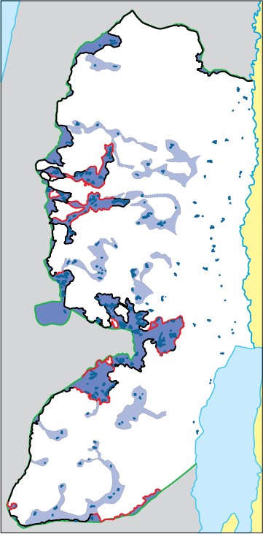
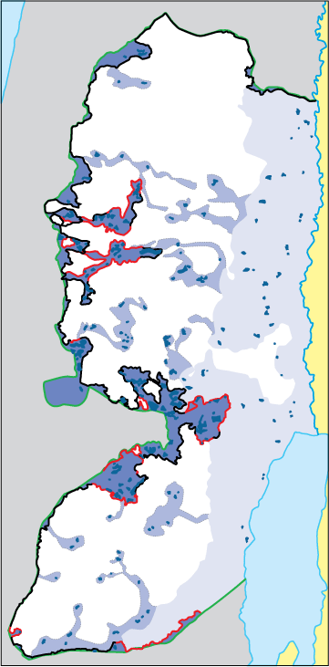
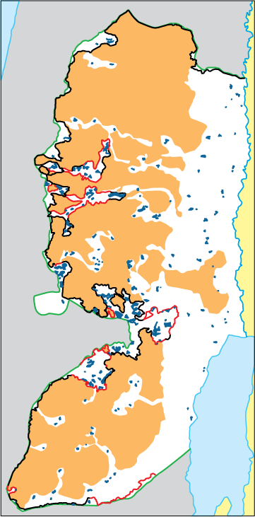
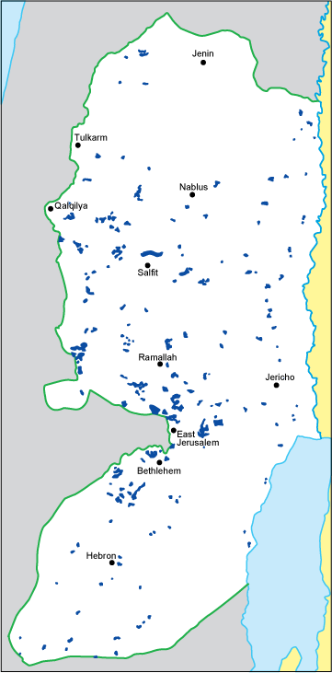
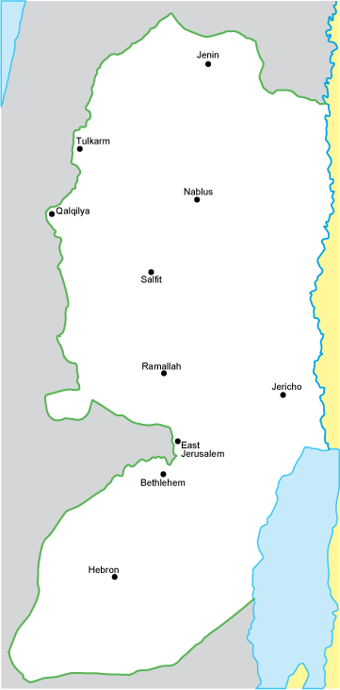
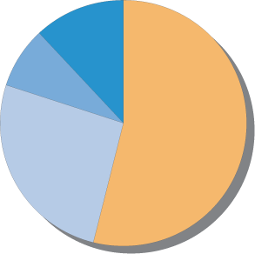
Facts on the Ground
Israel’s Settlement Enterprise
1. Settlements
2. The Wall (and its regime)
3. Settler / by-pass roads
4. Movement restrictions
WB land west of Wall: 9.0%
Settlement areas east of Wall: 8.0%
Jordan Valley settlement control: 28.5%
Area remaining for Palestinians: 54.5%

Slide 13
Demography
The total population of Palestinians is around 12 million; 4.700.000 in the P O T, (including East Jerusalem), 1.6 million in Israel, and 5 million in Arab countries and 700 thousand in other countries.
Almost 44% of the Palestinian people are refugees.
46.2% are children under the age of 18 years.
5.3 persons- average size of Palestinian family.
Unemployment rate is 27%.

Slide 14
Israeli Measures taken to keep its control on Land and people

Slide 15
1. Confiscation of Palestinian lands for the build up of settelments and by-pass roads.
The Gaza disengagement results to West Bank Engagement as Israel is making room for new settlers in West Bank and East Jerusalem. 8000 settlers were evacuated in Gaza and 500 from Jeneen ends with 30,000 new settlers in in 2008 in West Bank including East Jerusalem. Accordingly, 46% of the Palestinian Land of West Bank including the Jordan valley is annexed to Israel by de facto. The settler population in West bank can be estimated 500,670.

Slide 16
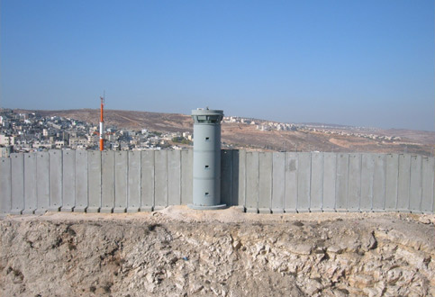
2. Construction of a separation barrier
This barrier represents further hardship to Palestinians especially that it does not coincide with the Green Line and in some places is located as much as 6 km inside the West Bank.

Slide 17
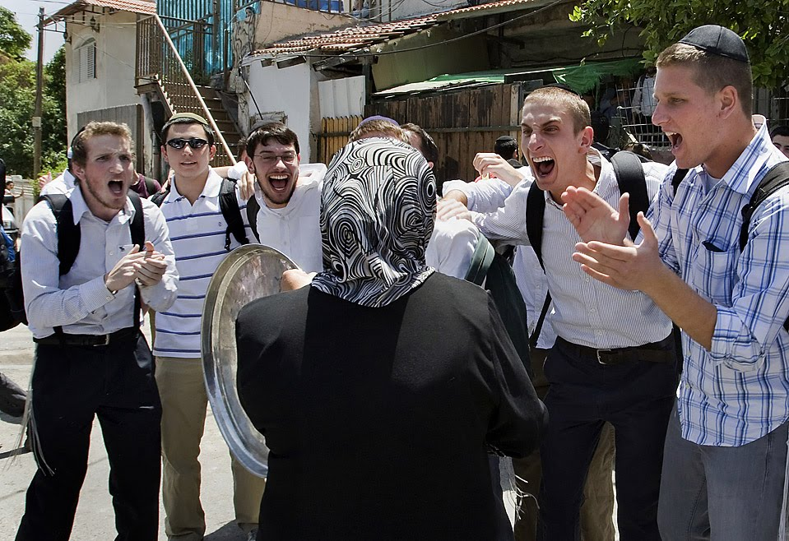
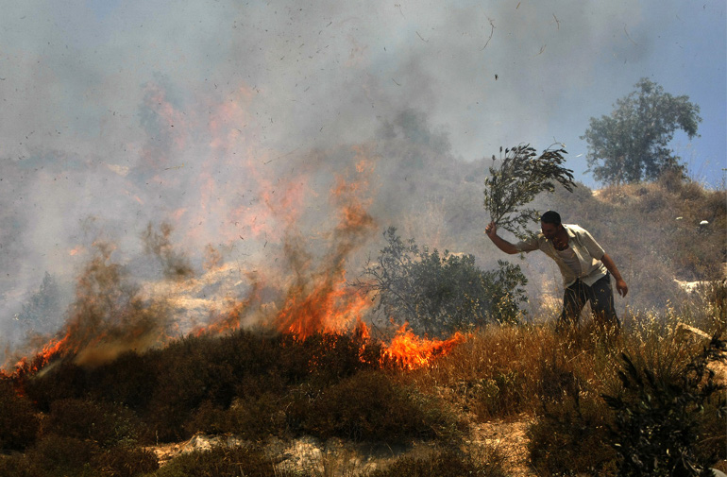
3. Settlements and settlers violence

Slide 18
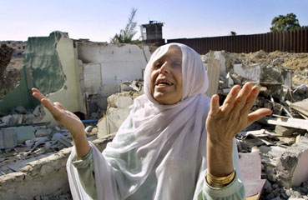
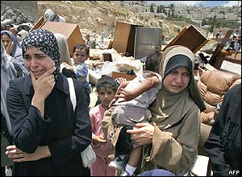
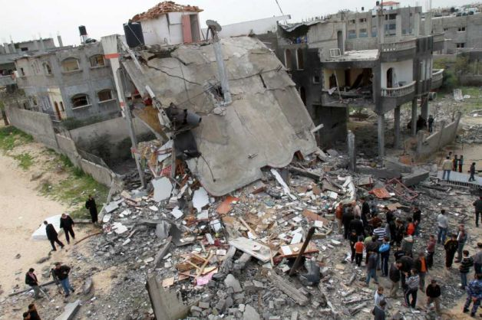
4. Demolition of homes

Slide 19
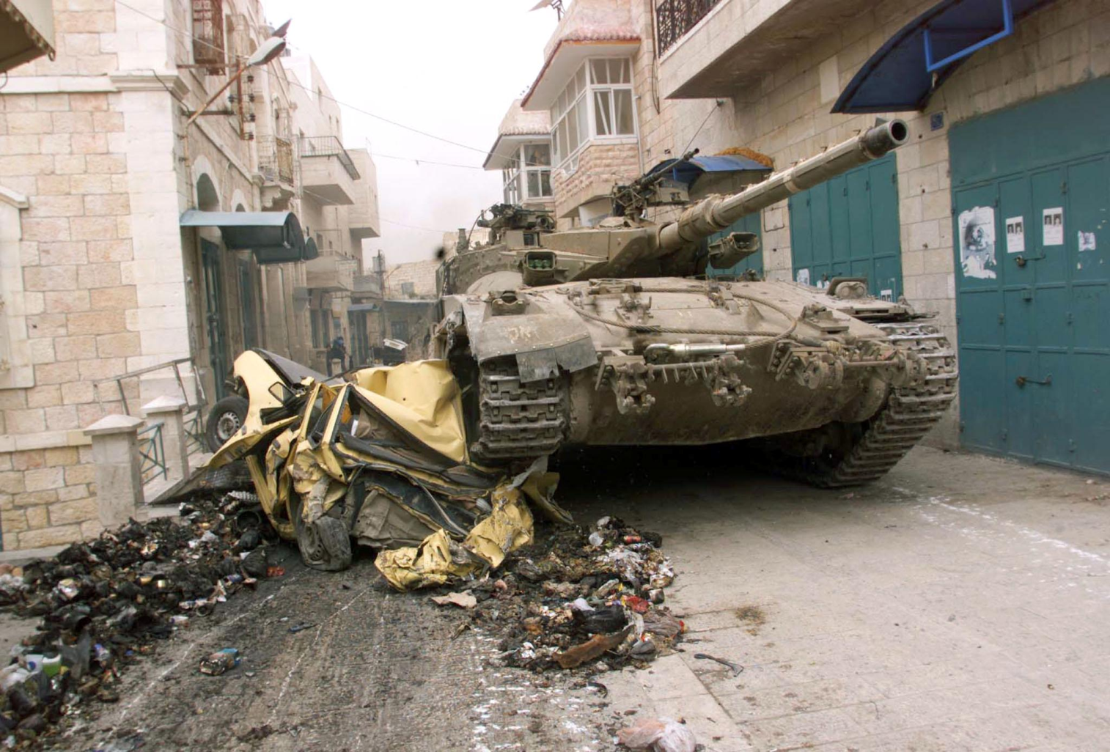
4000 institution businesses were demolished

Slide 20
With Our Own Hands
"New" policy of Israeli authorities forcing Palestinians to destroy their own homes.
2009: 82% of Palestinian Jerusalemites who received demolitions orders, were instructed to demolish their own homes.
Notes:
Note: ordered by Israeli officials, to put end to huge finance sanctions and fines

Slide 21
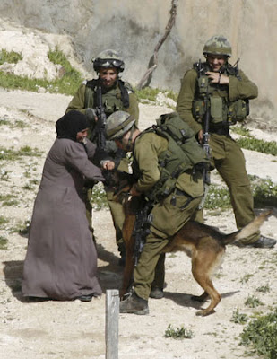
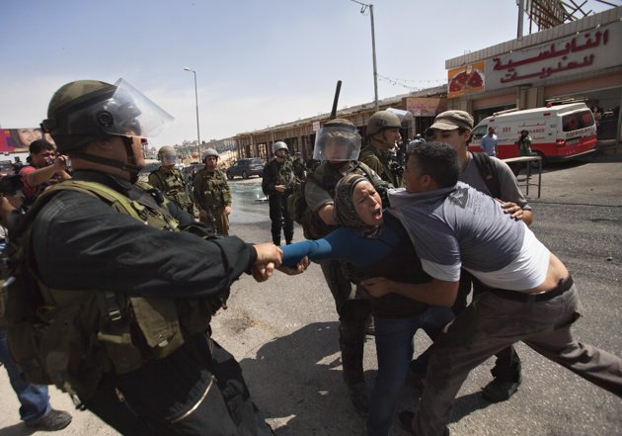
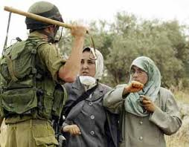
5. Violence and frightening people
A survey carried out by OCHA in the northern West Bank found that 72% of Palestinians had experienced regular verbal abuse and humiliation by IDF soldiers at checkpoints.

Slide 22
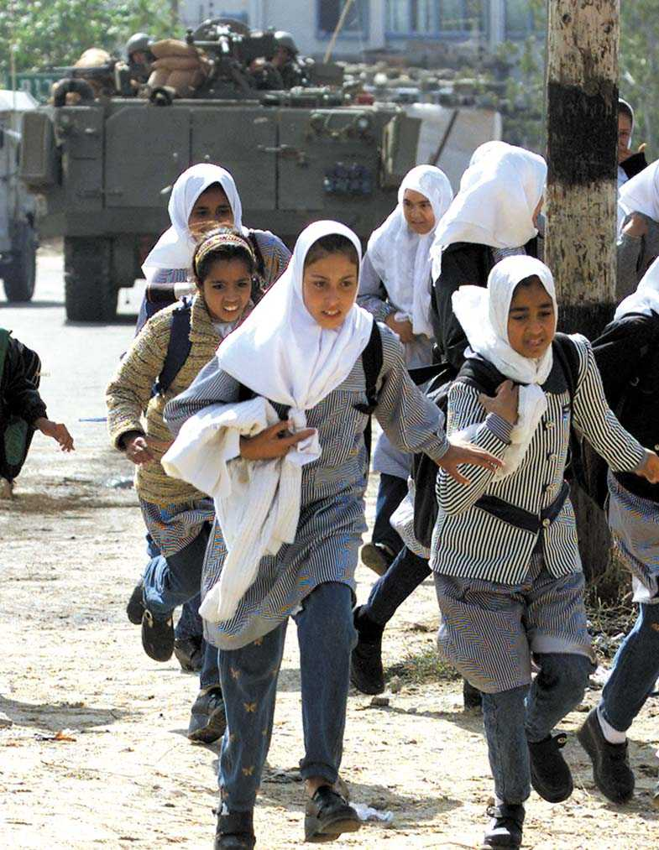
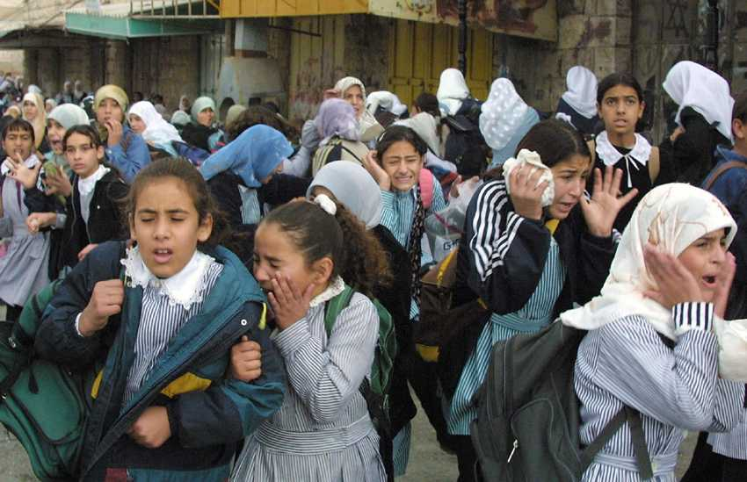
6. Shooting at schools, frightening students on their way to school or back home

Slide 23
7. Restriction of mobility
Israel maintains more than 600 checkpoints or roadblocks in the West Bank . As such, movement restrictions are also placed on main roads traditionally used by Palestinians to travel between cities, and such restrictions have been blamed for poverty and economic depression in the West Bank.

Slide 24
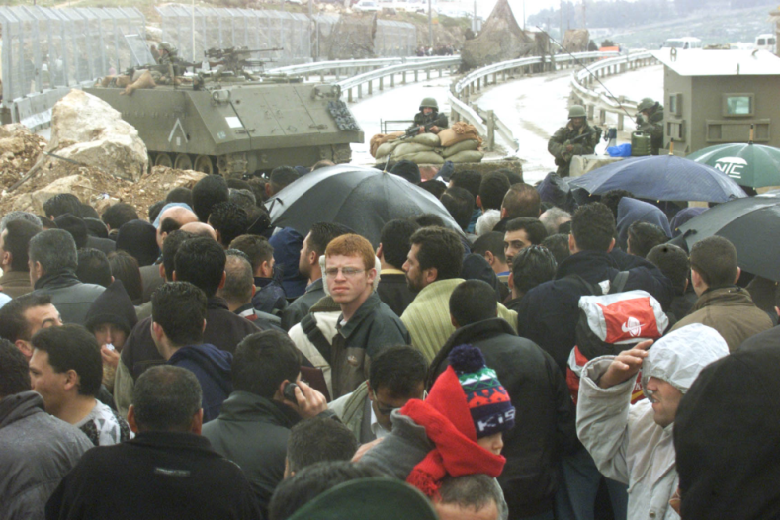
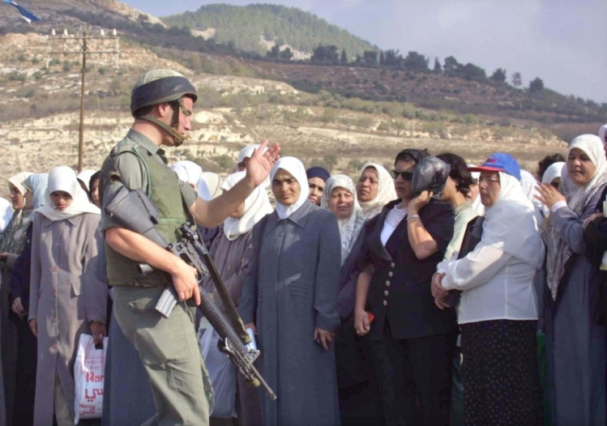
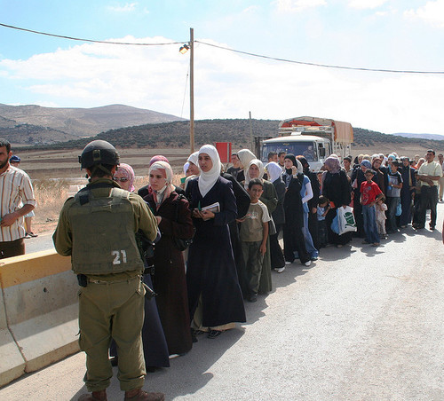
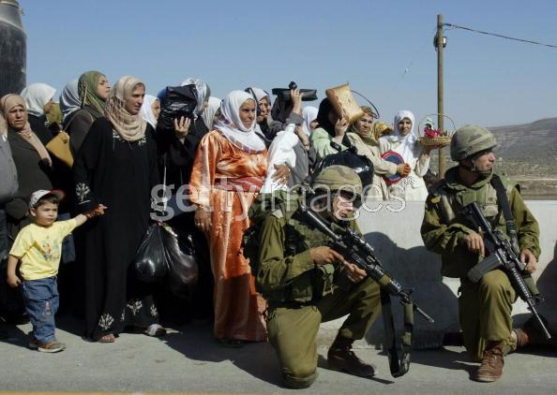
Closure and checkpoints restrict Palestinians from their right of movement

Slide 25
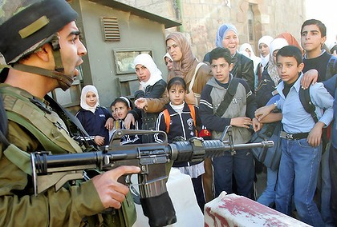
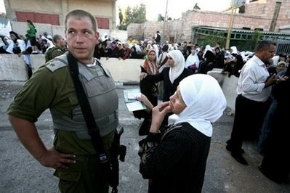
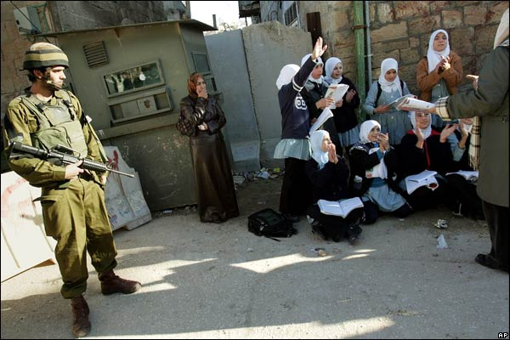
Violates the right of education by restricting the movement of people
2500 child forced to cross military checkpoints to reach schools

Slide 26
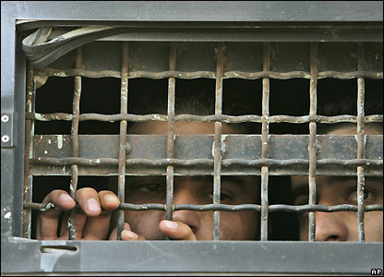
8. Palestinians in Israeli prisons
Since 1967 around 700.000 Palestinian were arrested or detained in Israeli prisons or detention centers
2010-2016 :4755 children were detained.
Jan-Aug 2015: 1322 detained children.
October 2015: 600 child detained, arrested and imprisoned.
165 child per month.

Slide 27
Occupation go beyond resulting in successive and cumulative injuries to individuals but aims to destroy social structures, relationships, and institutions.
Forms of political violence experienced directly influenced the collective health and well-being of populations and went beyond the loss of life and destruction of infrastructures.

Slide 28
Future
When trying to understand and develop the symptom trauma profile of the Palestinian plight, it is clinically critical that the international mental health society take into consideration how more than 72 years of on going Israeli military occupation significantly differs from the typical clinical research.

Slide 29
The Uniqueness of the Palestinian Case
Multiple and continuous traumas
Inter-generational trauma ; grandparents, parents, children, and grandchildren
Collective traumas on the whole community
Direct and symbolic traumas
Shocking reality; direct and indirect

Slide 30
The Uniqueness of the Palestinian Case
The trauma: non-specific event with no clear beginning or end
No post-traumatic condition
Self- traumatizing: the traumatized person is instructed to perform a self-defeating act
The absence of a clear division between the roles of the traumatic and traumatized (family and police)

Slide 31
The Uniqueness of the Palestinian Case
The absence of an actual safe place; reducing it until it reaches a completely emotional and symbolic meaning - for example, the case of Gaza
The therapist lives the same reality and identifies with the victim’s defense mechanisms
The primary aggressor is beyond the realms of accountability
Learned helplessness and the splitting mechanisms are critical for survival

Slide 32
The Uniqueness of the Palestinian Case
Indirect trauma may not be life-threatening
Avoidance is not possible
Difficulty in measuring action versus inaction
In the case of complex trauma, there are healthy external systems, whereas in the case of Palestine, the causes of trauma are general, historical, cross-generational, and omnipresent

Slide 33
Questioning the Classical Definition
Criterion A: stressor: continuous, external , internal, aggressor not held accountable, victim being accused to “ do harm “, caretakers are ordered to act as aggressors
Criterion B: intrusion symptoms : No safe area in Palestine, not intrusive symptoms but everyday reality
Criterion C: avoidance : not possible as traumatizing signs are everywhere everyday
Criterion F: duration : trauma is intergenerational, no perceived end
Criterion G: functional significance : depression and helplessness is a privilege people MUST continue living

Slide 34
CTSD
CTSD:
Continuous Traumatic stress Disorder
New terminology we suggest to better reflect the Palestinian situation of inter-generational “traumatization”, past, present and it seems for years to come.

Slide 35
Treatment:
Normal reaction to an abnormal situation
Address the abnormal “context” Palestinians live in
Treat the collective context instead of categorizing individuals
Hold Israel legally and morally accountable for endorsing colonial occupation

Slide 36

My Friend Khaled’s Story:
“I beep at the checkpoint!”

Slide 37
شكرا
Thank you!

